Slide 1

Room8s
Enter

Slide 2
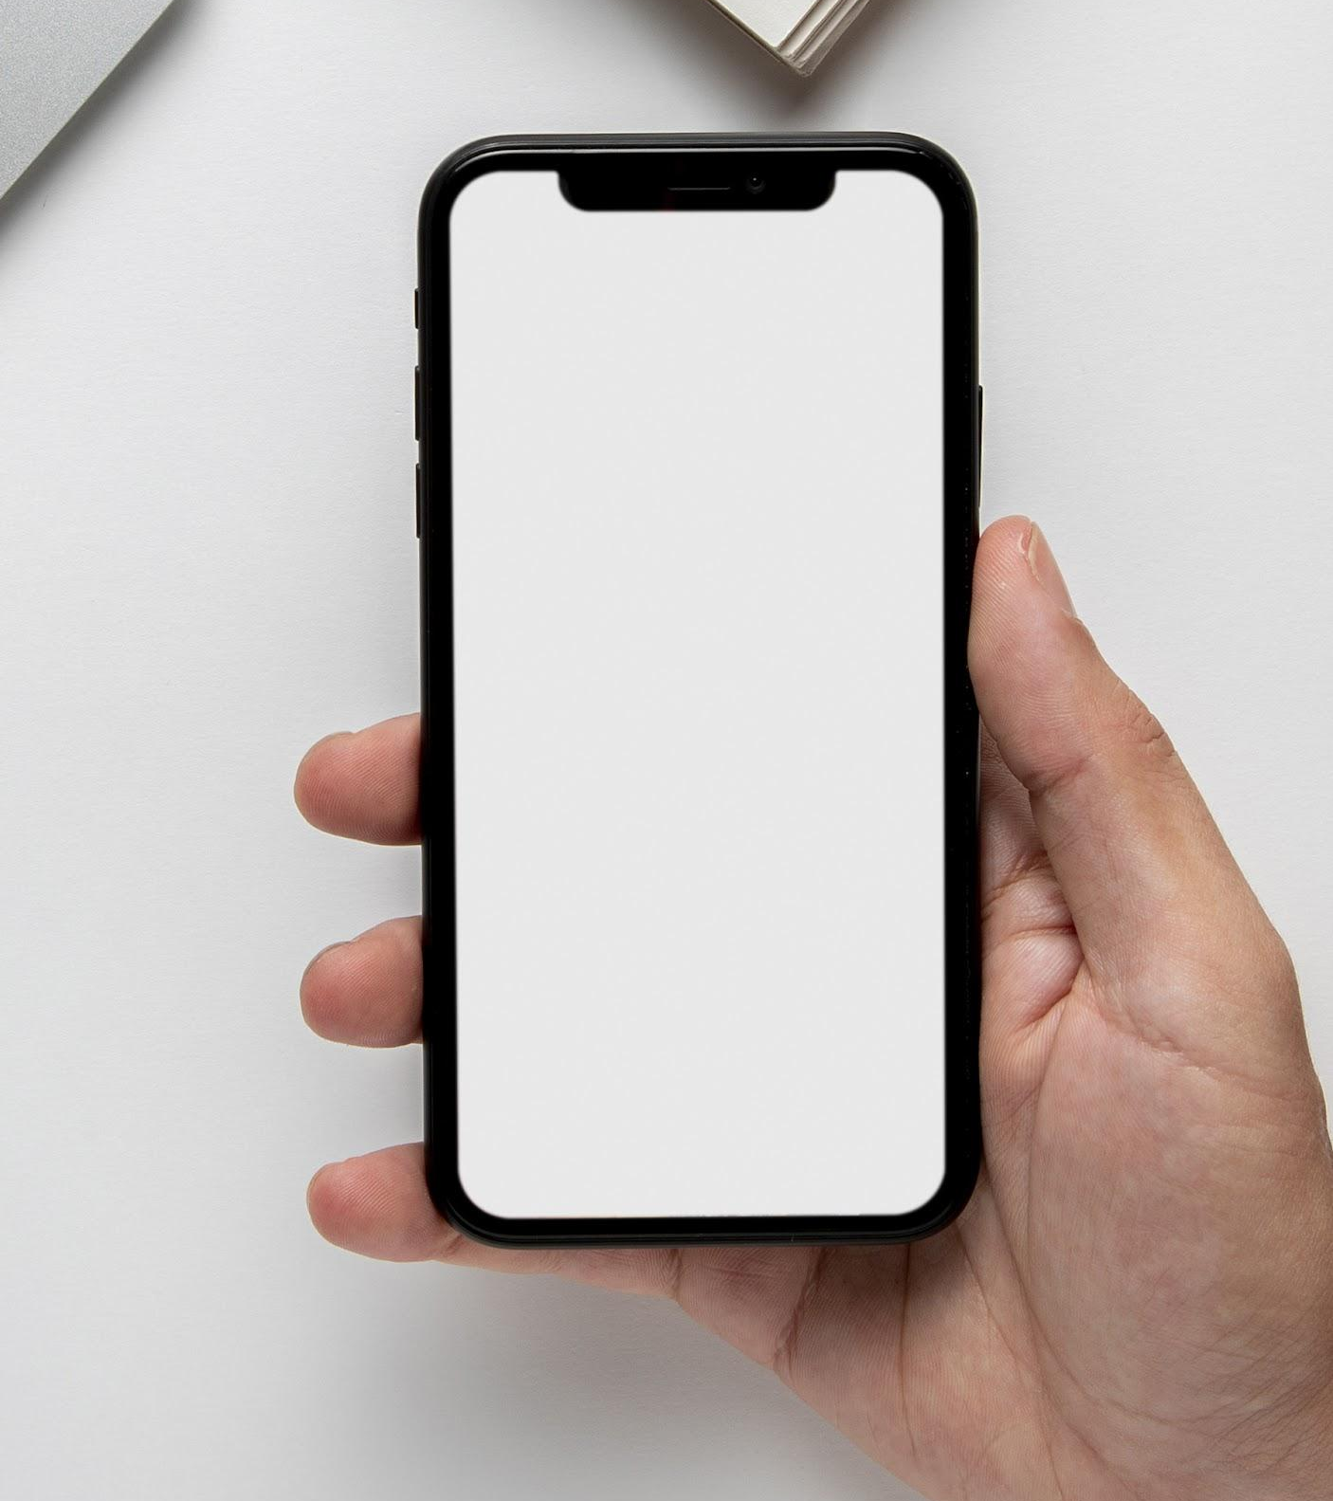
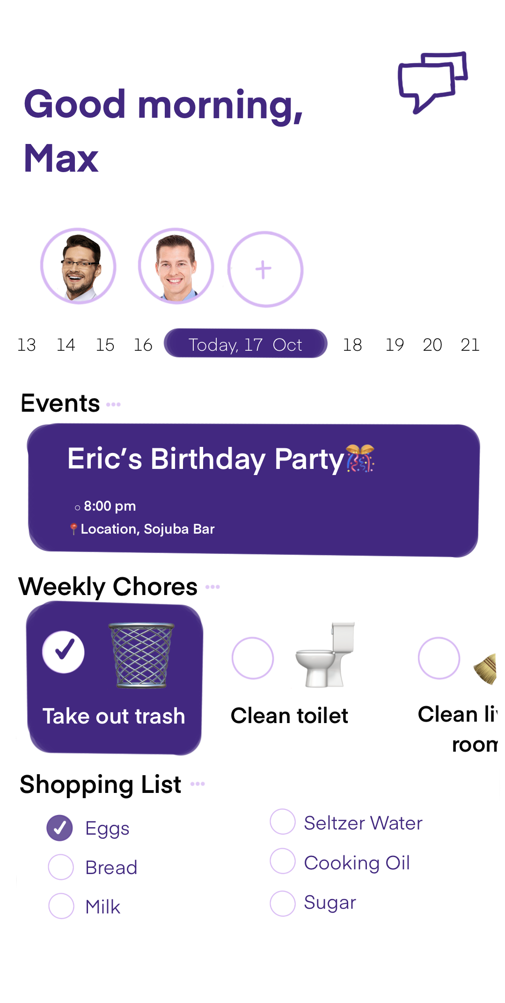
Introducing Room8s!
Room8s is a new up and coming organizational and social roommate app.

Slide 3
Problem?
Organization
Being a good housemate is very important and sometimes forgetting about important information can be detrimental. Thus the app allows one to stay more organized in order to be the best roommate possible
Social
Sometimes a person can feel lonely or not as comfortable to those that they share a home with. The app will utilize social features to bond more with roomates and become a closer unit within the home

Slide 4
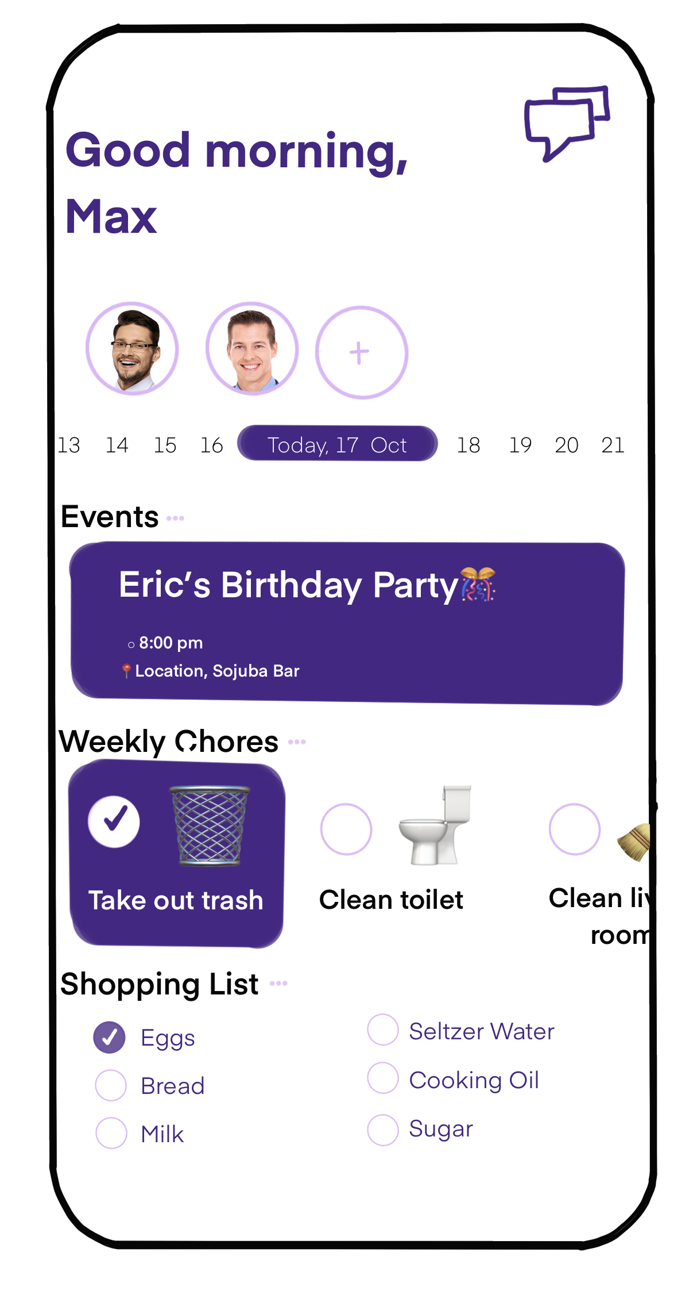

Slide 5

Not only will my app help keep its users organized with basic things like chores, events, shopping list etc. It will utilize a fun and interesting aspect to get to know your roommates more

Slide 6
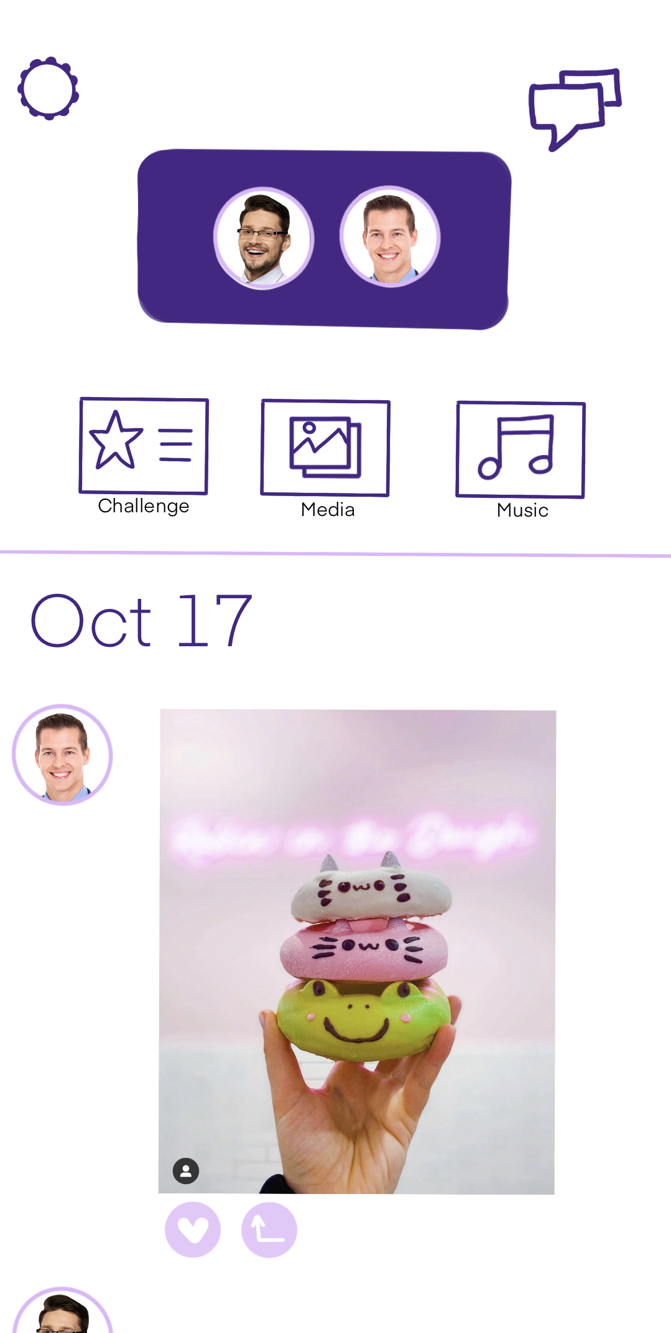

Slide 7
Example Challenge prompts
What is _______ favorite color?
Who is most likely to name their car?
What’s the worst advice you’ve ever been given?
Post a funny meme
Who is most likely to get discovered as a model?
If money were no object, where would you live?

Slide 8
Thank you! ♡
By Donna Petitti

